Slide 1
Department of Computer Science
Faculty of ICT

Slide 2
Computing Discipline

Slide 3
Agenda
Introduction
Background About Myself
Course Overview
Class Introductions
Approach to be used
Unit 1: The Computing Discipline
Questions/Discussion
End

Slide 4
About myself
ICT Lecturer with over 15 years of experience
Areas of specialty – Computer Vision, Image processing, Deep Learning
Publication - more than 10 papers published
Holds an Master’s Degree (Computer Science) and PhD Candidate
Sandile Mhlanga
mhlangast@tut.ac.za mhlanga.thamies@gmail.com

Slide 5
Course Overview
Expose students in the evolution and continuing developments in the field of Computing and its associated fields
At the end of this course your are expected to demonstrate knowledge of and engagement of Computing field (theories, research methodologies, methods and techniques)
The intent is to ensure that you are well-rounded, by interacting effectively with the changing environment
You will need to understand key items, concepts, facts, principles, rules and theories
Assessments will be conducted in this course. Schedule will be provided
No prescribed book
List of recommended reading material will be provided

Slide 6
Course Outline
The Computing Discipline
Cloud Computing.
Intelligent agents.
Internet of Things and smart environments.
Data mining and Big data.
Mobile Computing.
Networks and Cybersecurity.
Virtual and Augmented Reality.
Machine learning
Social and professional issues in Computing

Slide 7
Course Outline
Assessment | Due Date | Weight
Assignment | 28 Feb 2026 | 5%
Semester Test 1 | 28 March 2026 | 15%
Project (Article) | 30 April 2026 | 20%
Semester Test 2 | 09 May 2026 | 25%
Test/Exam | 30 May 2026 | 35%

Slide 8
Approach to be used
Presentations
Videos
Virtual
Tests, assignments, article writing
Verbal & Written feedback to your activities

Slide 9
UNIT 1: COMPUTING DISCIPLINE

Slide 10
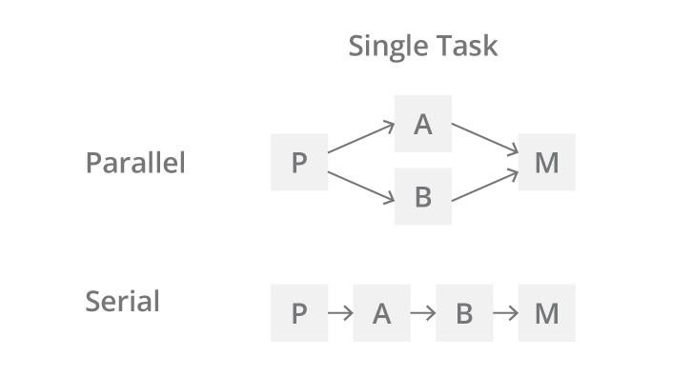
Computing Definition
Computer is a machine that takes in data, formats, stores and process it and generates an output
Super Computers do the same but faster with more data and in different ways
In the 80’s computers were serial processors i.e. they performed one task at a time
Now computers apply the concept of parallel processing – ie they can perform multiple tasks at a time

Slide 11
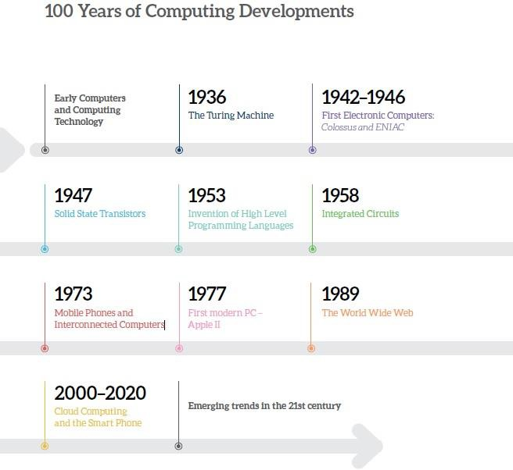
Evolution of Computing

Slide 12

Classical Computers vs Quantum Computers
Quantum computers use quantum mechanics to solve some specialized problems much faster than classical computers. Quantum computer is viewed as the next generation of classical computers.
Computers designed on today's chip technology will not continue to get cheaper and better. Quantum computer is an attractive next step in computer technology

Slide 13
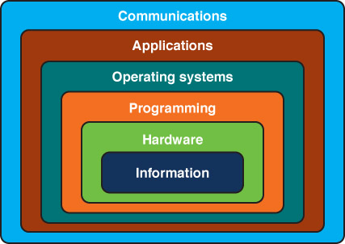
Layers of a Computing System
4

Slide 14
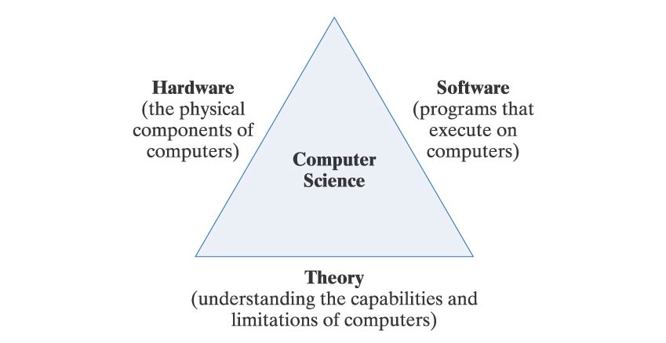
Computer Science Themes
Since computation encompasses many different types of activities, computer science research is often difficult to classify.
Three recurring themes define the discipline.

Slide 15
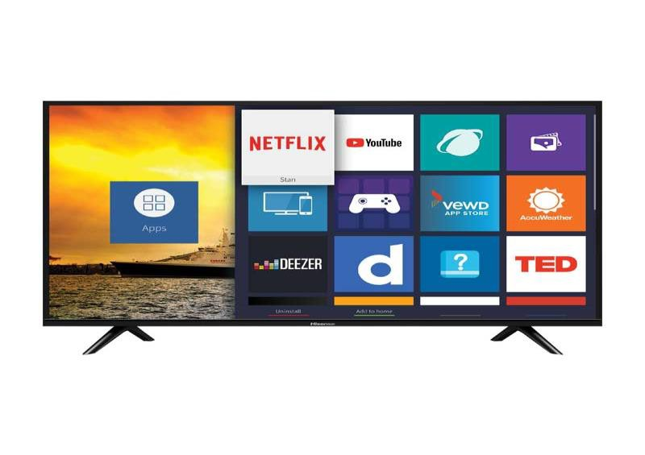
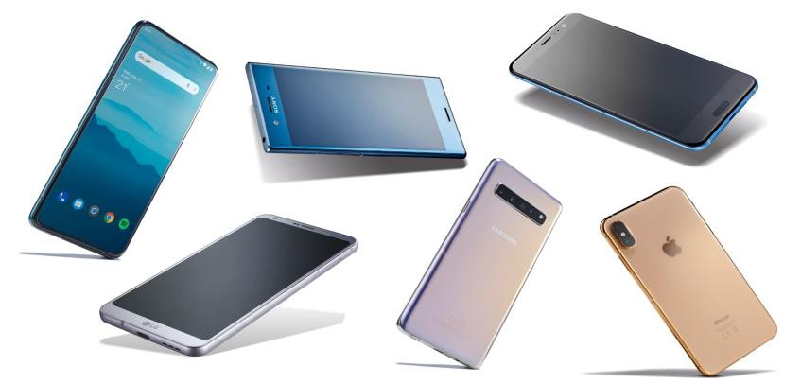
Learning Aspects of Computers
Google uses learning capabilities using large amounts of data – everyday occurrences
New computers seek to imitate the human brain
The more processing power is needed, the more power is required
Integrating traditional hardware with energy efficient system (Green ICT)
Smartphones are computers – they continue to learn, not getting smarter

Slide 16
Information Systems
Information Systems focus in applying computers to business problems.
Information systems are interrelated components working together to collect, process, store, and disseminate information to support decision making, coordination, control, analysis, and visualization in an organization.

Slide 17
Computer Engineering
Computer Engineering focuses on the design of the computer hardware and peripheral devices, often at the chip level.
Students learn how to design new computer circuits, microchips, and other electronic components. In addition, they learn how to design a new computer instructions and combine electronic or optical components to provide powerful, cost-effective computing.

Slide 18
Computer Science
Computer Science focuses on computer architecture and how to program computers to make them work effectively and efficiently.
Computer Scientists investigate the fundamentals theories of how computers solve problems, and they learn how to write application programs, system software, computer languages, and device drivers.

Slide 19
Information Technology
Information Technology degree programs focus on the computer equipment and software used by businesses and organizations-how they work, how they are secured, upgraded, maintained, and replaced.
Professionals in an IT typically work hands-on with hardware, networks, Web pages, multimedia, e-mail systems, and security.

Slide 20
Software Engineering
Software Engineering takes a discipline approach to developing software that is reliable, efficient, affordable, user-friendly, and scalable.

Slide 21
Systems Engineering
System Design Document
User Need
Concept
Definition
Requirements
Definition
System
Design
System Requirements
Concept
Allocated Hardware Reqs
Allocated Software Reqs
Notes:
Systems Engineering is the application of scientific and engineering methods to transform user needs into a description of the system that will fill those needs. Software engineers need to be intimately involved in systems engineering efforts to provide software expertise and assist in evaluating design decisions. Trade studies are performed and alternatives are evaluated to determine the most appropriate system design and allocation of system requirements to hardware and software. A required function in a car, for example, may perform much faster if it is implemented in hardware instead of software. However, it may be more expensive to implement in hardware. If the car being designed is a sports car, the increase in price may be acceptable. However, if it is a family car, the need to keep the price affordable may lead the systems designers to implement the function in software. It is important for the hardware and software engineers to be involved in the systems engineering activities to help the systems analyst make these kinds of trade-offs.
The above process shows how a specific car model would first be conceptually defined. Then more detailed requirements are determined and an initial design completed. Finally the systems requirements are separated and allocated to hardware related requirements and software related requirements. The software engineer helps determine what requirements are appropriate to implement in software. Items such as the digital dashboard displays, engine control systems like timing, fuel injection and emission control are all controlled by software. The software engineering process starts during the system engineering phase.
Note: Circles on this chart represent processes and parallel lines represent products which can be stored and retrieved.

Slide 22
Verification& Validation
Validate
Validate
Validate
Requirements
Analysis
Design
Code
Testing
Verify
Verify
Verify
Verify
Notes:
Verification and validation (V&V) is the process of determining whether the requirements for a system or component are complete and correct, the products of each development phase fulfill the requirements or conditions imposed by the previous phase, and the final system or component complies with specified requirements.
Validation is the process of evaluating a software component during the development process to determine whether it satisfies specified requirements.
Verification is the process of evaluating a software component to determine whether the product of a given development phase satisfies the conditions imposed at the start of that phase.
Human beings are fallible, and they make mistakes even if they adopt the most sophisticated and thoughtful design techniques, erroneous results can never be avoided. Consequently, the product of any engineering activity, such as our car, must be validated against its requirements throughout its development to ensure that errors are not propagated to later phases.
During the design and construction of our car, one must repeatedly verify the product in all its intermediate development stages. For instance, the first blueprints of the car are verified by using suitable equations to forecast whether the car’s frame will withstand the impact of an accident at 30 mph. Prototypes of the car are also built to further enhance confidence. And throughout the development phases the software design, code, and test would be compared to the requirements to validate that the car is being built as initially specified. For instance, can the car do 0 to 60 mph in the specified 10 seconds.

Slide 23
System Requirements Checklist
Clarity
Is the terminology consistent with the user’s?
Are the requirements clear and unambiguous?
If assumptions that affect implementation have been made, are they stated?
Completeness
Have all requirements been assigned a priority?
Have the criteria for assigning priority levels been defined?
Have the requirements been stated for each staged implementation?
Consistency
Are the requirements consistent with each other?
Are the requirements here consistent with the requirements in related documents?
Testability
Have the test methods (test, demonstration, analysis or inspection) been stated for each requirement?
Notes:
This list shows a small subset of questions asked during the Formal Inspection of the software requirements document.

Slide 24
Main Computing Disciplines: Characteristics, Similarities, and Differences
Computing has been defined by The Joint Task Force for Computing Curricula 2005 as “any goal-oriented activity requiring, benefiting from, orcreating computers. [ It uses knowledge and skills from other disciplines, like mathematics, science, engineering, and business. Computing is really a family of disciplines consisting of several more specific computing disciplines, like Computer Engineering (CE), Computer Science (CS), Software Engineering (SE), Information Technology (IT) and Information Systems (IS). Originally there were only three kinds of computer-related disciplines: Electrical Engineering for students interested in hardware, Computer Science for student interested in programming, and Information Systems for students interested in using hardware and software to solve business problems. Inthe late 1970s, Computer Engineering (CE) emerged from Electrical Engineering to focus on the design and programming of chips that control devices. Software Engineering emerged from Computer Science in the 1980s and 1990s to design and create comprehensive applications software, combining Computer Science principles and techniques with engineering practices. Information Technology emerged in the late 1990s, to take care of the computing infrastructure in organizations, a gap not being addressed by CE, CS, SE, and IS.

Slide 25


2
Comparison between the main computing disciplines:
# | Discipline | Brief description | Examples of topics emphasized | Location | Who should study this discipline
1 | Computer Engineering (Computer Engineering emerged from Electrical) | Computer Engineering focuses on the design, construction, and programming of the chips that digitally control many | Computer architecture and organization, Digital logic, Analysis of technical requirements, Embedded systems, | CE programs are usually located in an engineering school. | Suitable for students who are mostly interested in hardware design. For example, students who want to design or build computers or computing

Slide 26
3
Comparison between the main computing disciplines:
# | Discipline | Brief description | Examples of topics emphasized | Location | Who should study this discipline
2 | Computer Science (Computer Science is one of the three original computing disciplines, first appearing as a discipline in the 1960s.) | Computer Science focuses in developing and maintaining computer software. On one side, it focuses in the development of new knowledge and techniques to enhance and make more efficientthe computing discipline. Additionally, CS focuses in the application of current knowledge and techniques to | Programming fundamentals, Algorithms, Programming languages, Computer architecture and organization, Artificial intelligence, Information management theory and practice, Software design, Security issues and principles, Data structures, and Operating | CS programs are usually located in the School of Sciences. | Suitable for students who are highly interested in programming. Also, for students interested in research, as well as in the theoretical and formal aspects of computer software.

Slide 27
4
Comparison between the main computing disciplines:
# | Discipline | Brief description | Examples of topics emphasized | Location | Who should study this discipline
3 | Software Engineering | Same as Computer Science does, Software Engineering focuses in developing and maintaining computer software. SE combines computer science principles and techniques with engineering practices to design and create comprehensive and large-scale “applications software”, like Inventory Control systems, Airline Reservation systems, and Loan Origination and Processing systems. | Programming fundamentals, Algorithms, Programming languages, Computer architecture and organization, Information management theory and practice, Software design, Security issues and principles, Operating systems principles and design, Engineering foundations and economics for software, Software design, Software verification and | SE programs are located in several schools, including the Engineering School, and the School of Sciences. It is sometimes located also within the Computer Science department, either as a separate program or combined with Computer Science. | Suitable for students who are highly interested in designing and programming comprehensive and large-scale applications software, to be implemented in organizations or used by individuals. Also, for students interested in combining computing knowledge and techniques with engineering practices.

Slide 28
5
Comparison between the main computing disciplines:
# | Discipline | Brief description | Examples of topics emphasized | Location | Who should study this discipline
4 | Information Technology | Information Technology focuses on deploying and supporting the computing infrastructure in organizations. That is, deploying and supporting servers, desktops, communication networks, operating systems, and platform applications (like office systems, email and web related software). It makes sure that computing infrastructure is suitable, is available, and works reliably. It puts more emphasis on the integration of hardware, software, and communication networks into a technological | Configuring and operating the components of the computing infrastructure in an organization, Operating systems configuration and use, Security implementation and management, Design and implementation of local and wide area networks, Hardware warranty, maintenance and support, Installation and configuration of infrastructure software, Analysis of technical requirements, Web site | IT programs are located in several schools, including the Engineering School, the Business School, and an independent school. | Suitable for students who are highly interested in deploying and supporting the use of technology in organizations. (Implementing and operating servers, desktops, local area networks, wide area networks, and other components of the computing infrastructure in organizations requires more technical skills and less client- facing skills. But IT specialists also provide technical support to users of the computing infrastructure, in which case students must also like to interact with people, besides interacting with technology.)

Slide 29
6
Comparison between the main computing disciplines:
# | Discipline | Brief description | Examples of topics emphasized | Location | Who should study this discipline
5 | Information Systems | Information Systems emphasizes the deployment and support of computing applications to enable organizational processes in order to make organizations more effective, efficient, and competitive. IS specialists select and acquire, the software products developed by Computer Scientists, and the comprehensive applications developed by Software Engineers, deploy them on top of the infrastructure deployed by Information Technology specialists, and integrate these products into afunctional solution. They make sure that | Business process analysis and reengineering, Application requirements definition, Applications procurement, deployment, training, and support, E-Business applications, Project management, Business intelligence and data mining, Managing data centers, and Data security and control. Programming and computing infrastructure are emphasized only to ensure students understand how these components work and fit together, although some | IS programs are usually located in the School of Business, although recent trends have also located them in other functional areas like Public Administration and Health Administration. | Suitable for students who are interested in procuring, implementing and supporting computing applications within an organizational context. In order to do so, students must be interested in obtaining a combination of both technical and functional (Accounting, Marketing, Strategic management, etc.) knowledge, which would enable them to act as a bridge between the more technical and the functional staff in organizations. IS students must also like to interact with people, besides interacting with technology.

Slide 30

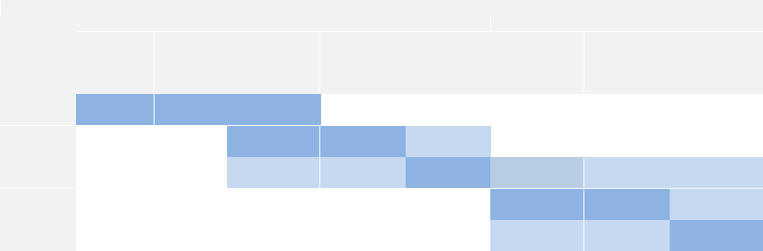










7
Orientation of the main computing disciplines towards product development, product deployment and user support:
Discipline | Products developed |  |  |  |  | Products deployed (implemented)
 | Hardware | Hardware- embedded software | Creation of new knowledge & | Infrastructure software (OS, tools, platforms) | Application software | Hardware infrastructure | Infrastructure software (OS, tools, platforms) | Applications software
Computer Engineering | High | High | High | (No standalone software development) |  | (No direct deployment to users)
Computer Science | (No hardware development) |  | High | High | Low | (No direct deployment to users)
Software Engineering | (No hardware development) |  | Low | Low | High | Low | Low | Low
Information Technology | (No hardware/software development) |  |  |  |  | High | High | Low
Information Systems | (No hardware/software development) |  |  |  |  | Low | Low | High

Slide 31


8
Orientation of the main computing disciplines towards product development, product deployment and user support (continued):
Discipline | User support provided to products already deployed
 | Hardware infrastructure support | Infrastructure software support | Applications software support | Functional support
Computer Engineering | (No direct support to users)
Computer Science | (No direct support to users)
Software Engineering | (No direct support to users)
Information Technology | High | High | Low
Information Systems | Low | Low | High | High

Slide 32
Computing Fields
 | Field | Definition
 | Computer Engineering | Combines the fields of electrical engineering and computer scien ce to create new computer hardware and software
 | Computer Science | This is the discipline of solving problems via solutions that are implemented on computer
 | Cyber security | The practice of defending computers, servers, mobile devices, electronic systems, networks, and data from malicious attacks
 | Software Engineering | A branch of computer science which includes the development and building of computer systems software and applications software.

Slide 33
Computing Fields…
 | Field | Definition
 | Information system | Information system (IS) refers to a collection of multiple pieces of equipment involved in the collection, processing, storage, and dissemination of information. Hardware, software, computer system connections and information, information system users, and the system’s housing are all part of an IS.
 | Information Technology | Falls under the IS umbrella but deals with the technology involved in the systems themselves. Information technology can be defined as the study, design, implementation, support or management of computer-based information systems. Includes hardware, software, databases and
 |  | networks.

Slide 34
Bodies of Knowledge
 | Body of Knowledge | Definition
 | Discrete Structures | The branch of mathematics dealing with objects that can consider only distinct, separated values.
 | Programming Fundamentals | Analysis; developing understanding; generating algorithms; verifying the requirements of algorithms, and implementation of algorithms in a target programming language
 | Architecture and Algorithms | The complexity of an algorithm computes the amount of time and spaces required by an algorithm for an input of size (n). The complexity of an algorithm can be divided into two types. The time
 |  | complexity and the space complexity.

Slide 35
Bodies of Knowledge….
 | Body of Knowledge | Definition
 | Operating System | An interface between a computer user and computer hardware.
 | Programming Languages | A language programmers use to develop software programs, scripts, or other sets of instructions for computers to execute.
 | Human-Computer Interaction | A field of study focusing on the design of computer technology and, in particular, the interaction between humans and co mputers.

Slide 36
Bodies of Knowledge
 | Body of Knowledge | Definition
 | Graphics and Visual Computing | discipline that combines computer graphics and computer vision to advance technologies for the capture, processing, display and perception of visual information
 | Intelligent Systems | A machine with an embedded, Internet- connected computer that has the capacity to gather and analyze data and communicate with other systems. Capacity to learn from experience, security, connectivity, the ability to adapt according to current data and the capacity for remote monitoring and management.

Slide 37
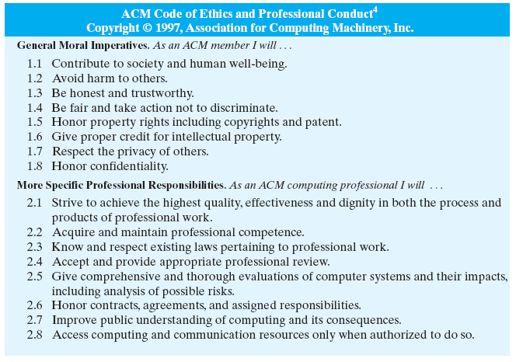
The Ethics of Computing
As technology becomes more prevalent in society, computing professionals must ensure that hardware and software are used safely, fairly, and effectively

Slide 38

Questions/Discussion

Slide 39

THANK YOU

